Slide 1

Digital Time Capsule
Preserve today. Unlock tomorrow.

Slide 2


THE VISION
A Legacy Forged in Time
Capturing Moments
Imagine a secure vault where your most cherished memories, heartfelt messages, and significant goals reside, waiting to be rediscovered. A digital sanctuary for your legacy.
Journey to Tomorrow
Our digital time capsule concept is a bridge to the future, allowing you to intentionally store videos, photos, and aspirations, creating a profound connection with your future self and loved ones.

Slide 3

THE CHALLENGE
Where Do Memories Go?
Scattered Fragments
Lost in the Digital Ether
Our precious moments are often fragmented across countless chat histories, sprawling cloud folders, and transient social media feeds, making them nearly impossible to revisit cohesively.
Without a dedicated space, the true essence and intentionality of our memories fade, leaving us without a meaningful way to reflect on our journey or share it with the future.

Slide 4

OUR SOLUTION
Your Intentional Memory Vault
The Digital Time Capsule offers a secure and thoughtful haven for your most valued memories. It's more than just storage; it's a commitment to your future self and the people who matter most.
Crafted with intention, our platform ensures your digital treasures are not just saved, but truly preserved, waiting to be unveiled on a chosen date in the future.
Secure Preservation
Future Unlocks
Emotional Connection

Slide 5
KEY CAPABILITIES
Effortless Memory Curation
Seamless Access
Custom Capsules
Rich Content
Intuitive user sign-up and secure login to begin your journey.
Create private, public, or shared capsules tailored to your needs.
Effortlessly upload text, images, and videos into your capsules.
Anticipation Building
Explore & Share
Set countdown timers for the exciting moment your capsules unlock.
Discover and contribute to public capsules, fostering collective memories.

Slide 6






YOUR JOURNEY
An Emotional Flow
Home
Inspiring storytelling & clear call to action.
Create Capsule
Multi-step guided process for thoughtful creation.
Set Unlock Date
Choose your moment for future revelation.
Add Content
Enrich your capsule with text, visuals, and audio.
Countdown
Anticipation grows with each passing day.
Unlock Moment
A powerful, emotional rediscovery.

Slide 7
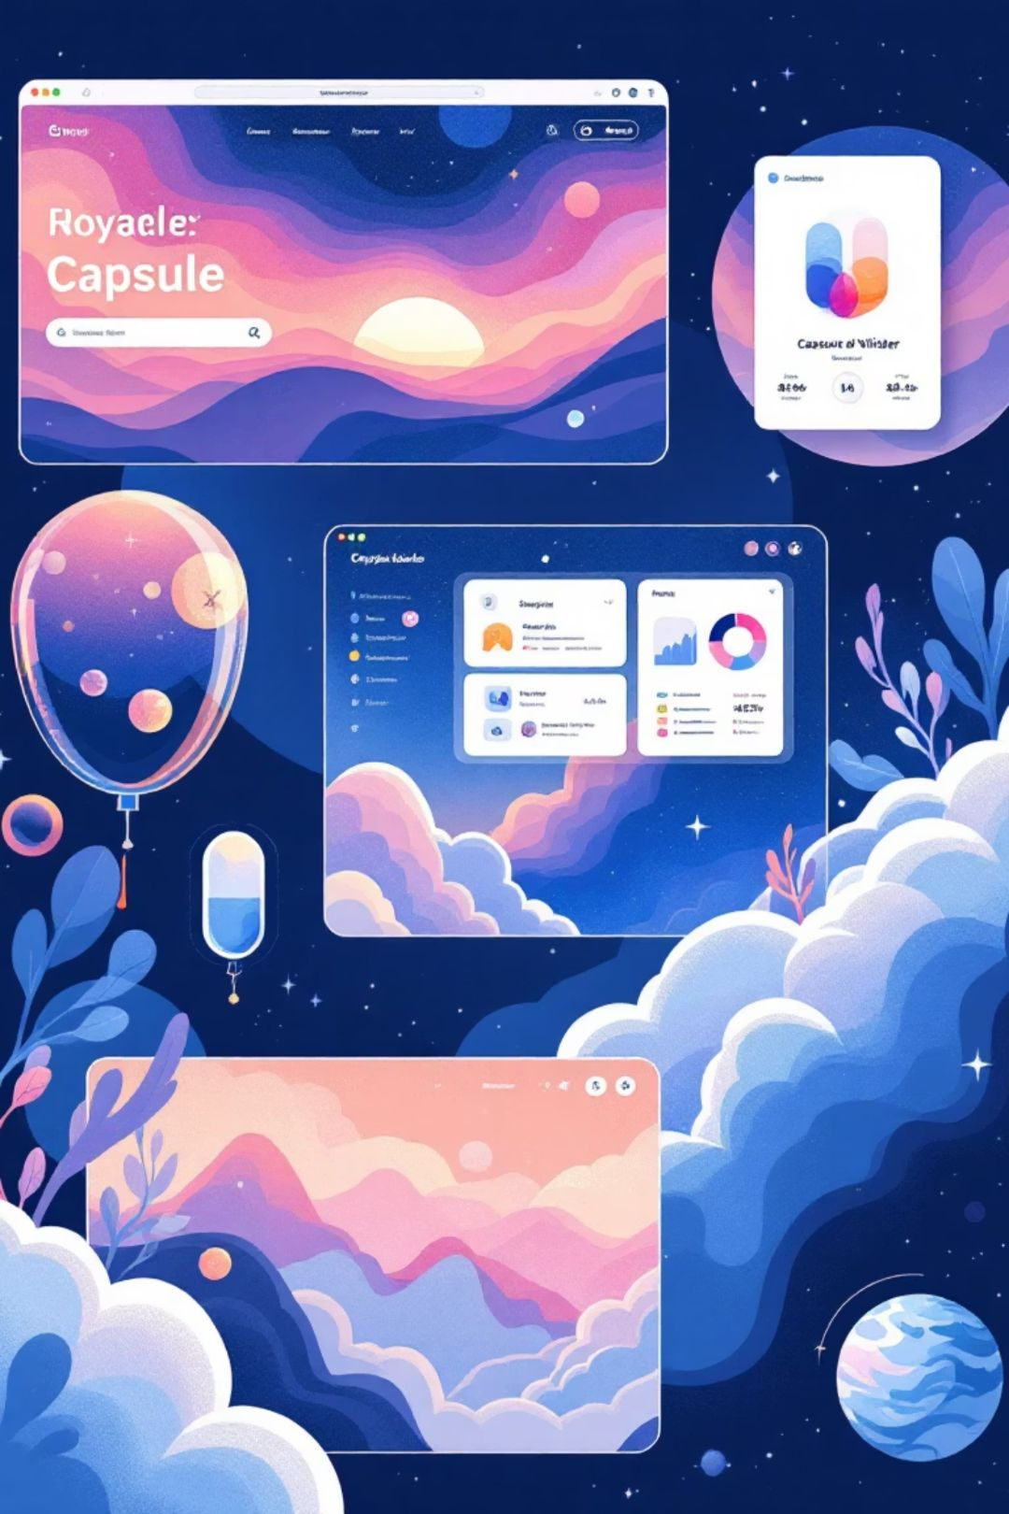
BEHIND THE SCENES
Intuitive Pages, Powerful Purpose
Home
Engaging storytelling and clear calls to action.
Create Capsule
A guided, multi-step flow for crafting your future message.
Explore Public
Discover and interact with shared memories from around the world.
Dashboard
Manage your capsules, monitor countdowns, and track your legacy.

Slide 8

AESTHETIC & EXPERIENCE
Cosmic Elegance, Human Touch
Cosmic Dark Theme
Deep blues and purples evoke the vastness of space, creating a serene and timeless backdrop for your memories.
Glassmorphism UI
Transparent, frosted elements provide depth and a modern, ethereal feel, highlighting content with clarity.
Subtle Animations
Gentle transitions and floating elements create a dynamic, engaging, and futuristic user experience.
Responsive Design
Flawless accessibility across all devices, ensuring your memories are always within reach.

Slide 9




WHO WE SERVE
Crafted for Every Journey
Built for students, creators, couples, and reflective minds who believe some memories are worth waiting for.
Students
Creators
Document growth, set goals, reflect on academic journeys.
Preserve ideas, track projects, celebrate artistic milestones.
Reflective Users
Couples
Thoughtfully store personal reflections, aspirations, and life lessons.
Capture shared moments, anniversaries, and future dreams.

Slide 10

Some Moments Are Meant to Wait.
Your future self will thank you.

